Slide 1






Mentorship program
COURSE’S DETAIL
Khuat Bao Nguyen

Slide 2

Course’s Detail Page

Slide 3



Agenda
01
02
Database Design
MySQL Queries
Mentorship program

Slide 4
Database Design
1
Brainstorm
2
Use AI to create database
3
Create sample data
4
Redesign database

Slide 5
BRAINSTORM

Slide 6
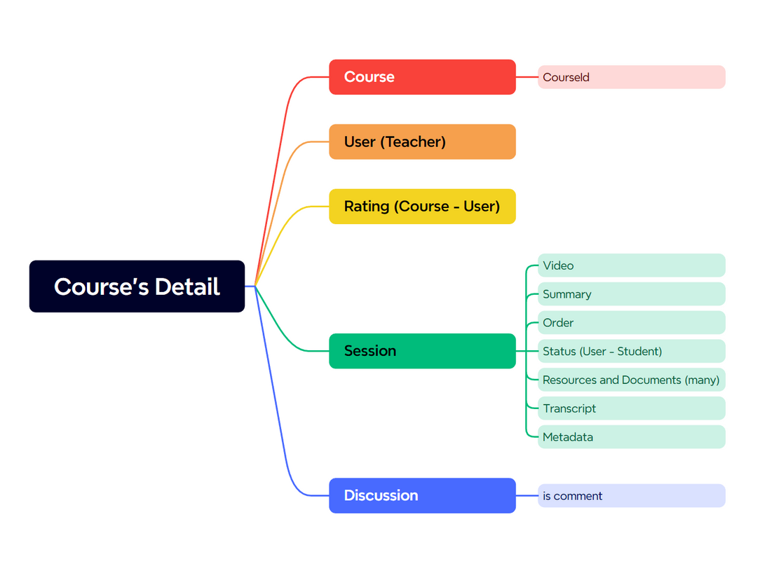
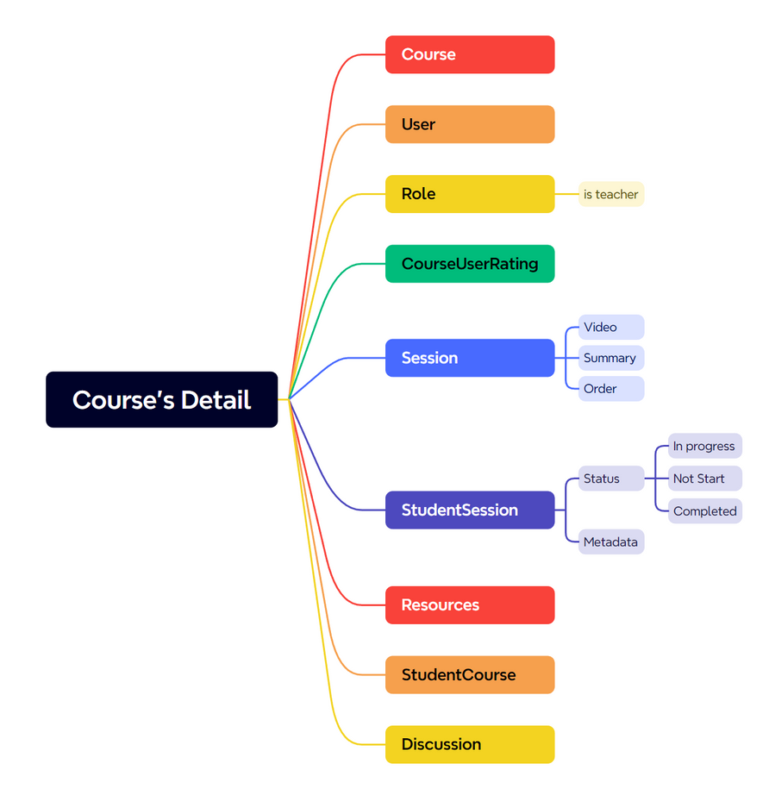
Scan Page

Slide 7
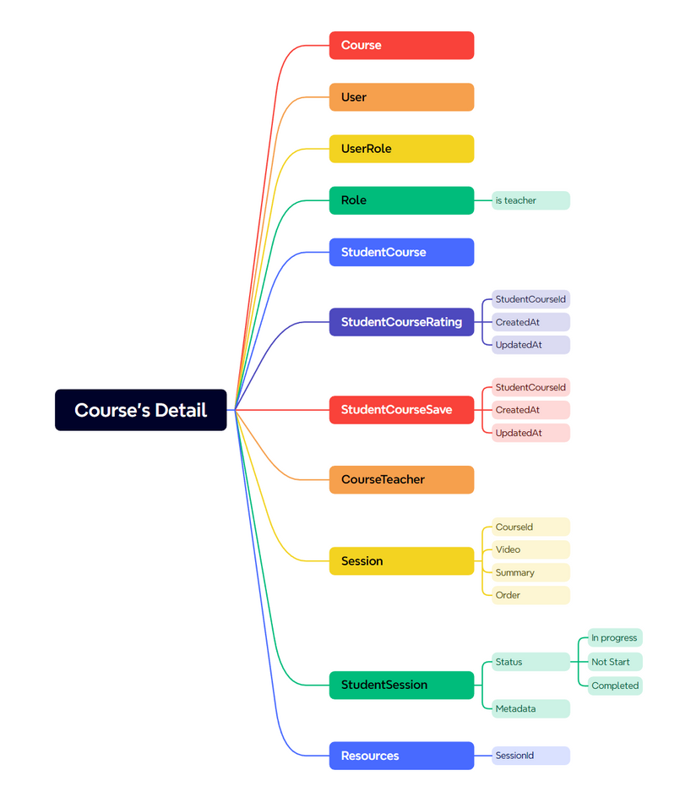
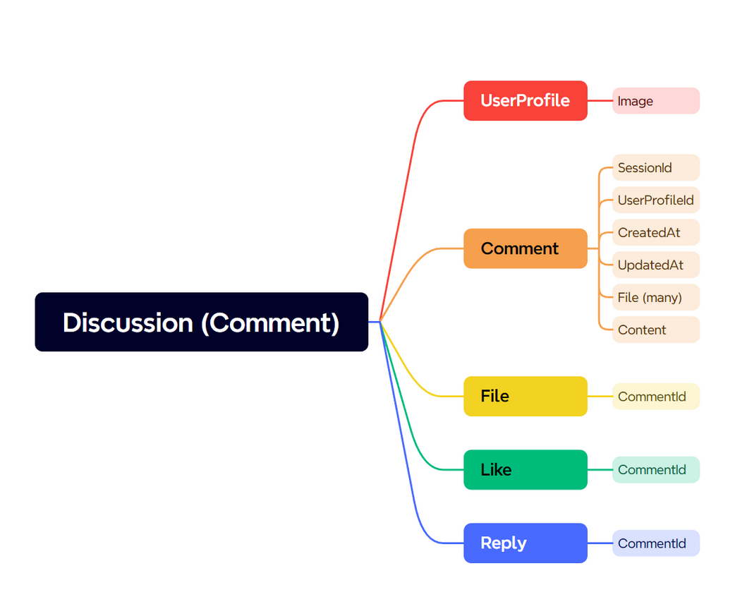
Define Relationships

Slide 8
USE AI TO CREATE DATABASE

Slide 9
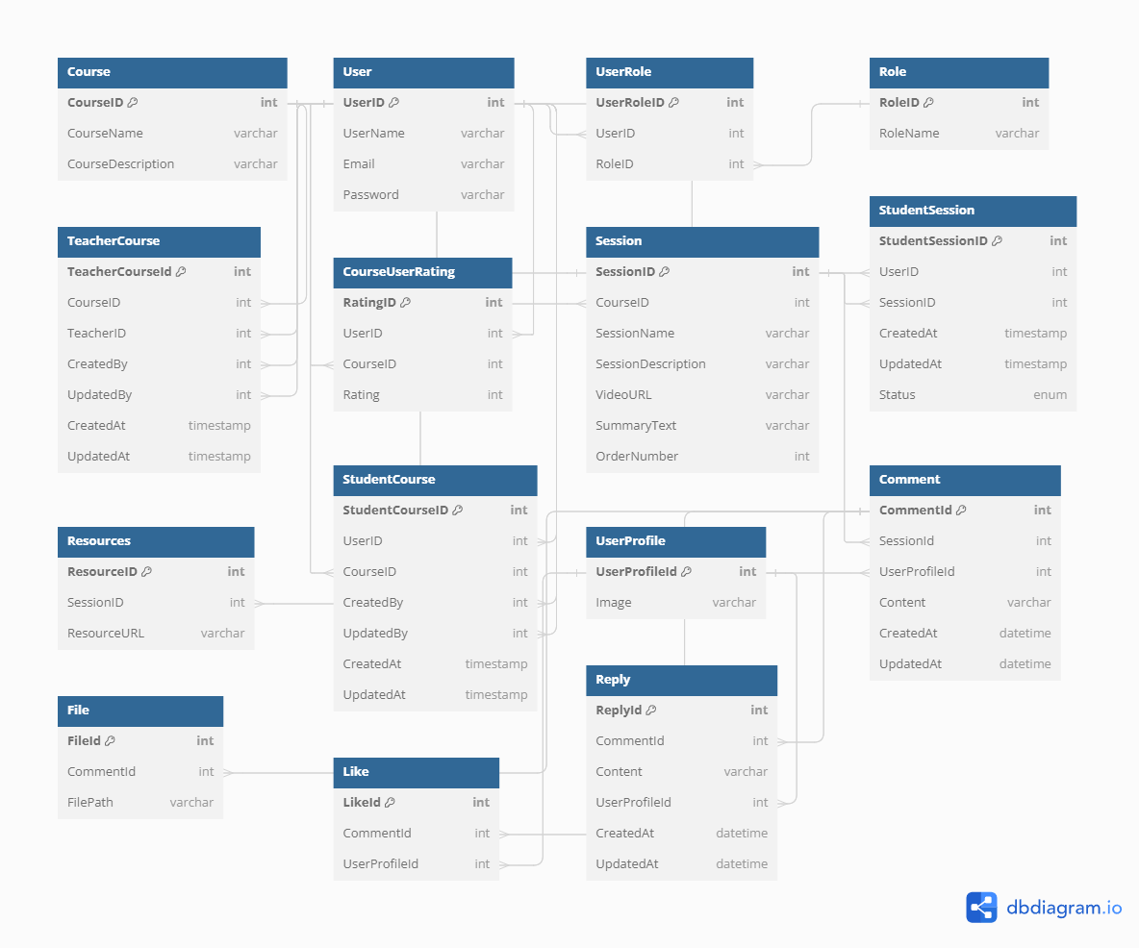

Slide 10
CREATE SAMPLE DATA

Slide 11
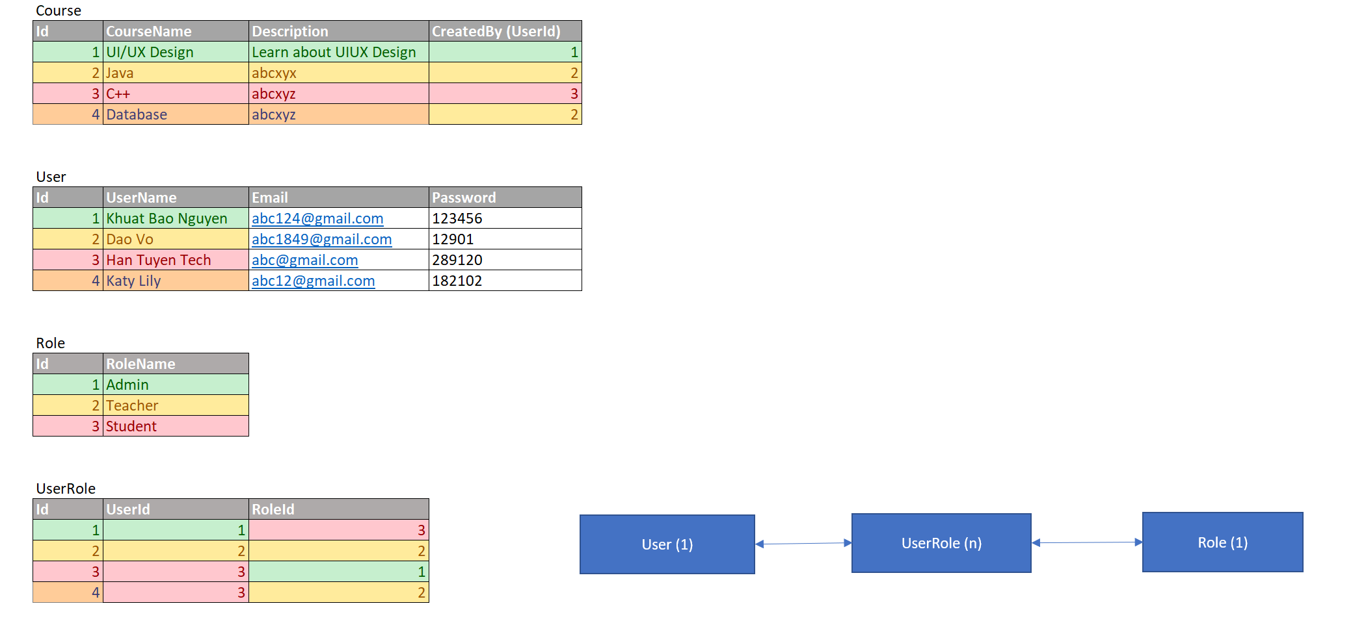
CREATE DATA IN EXCEL

Slide 12
REDESIGN DATABASE

Slide 13
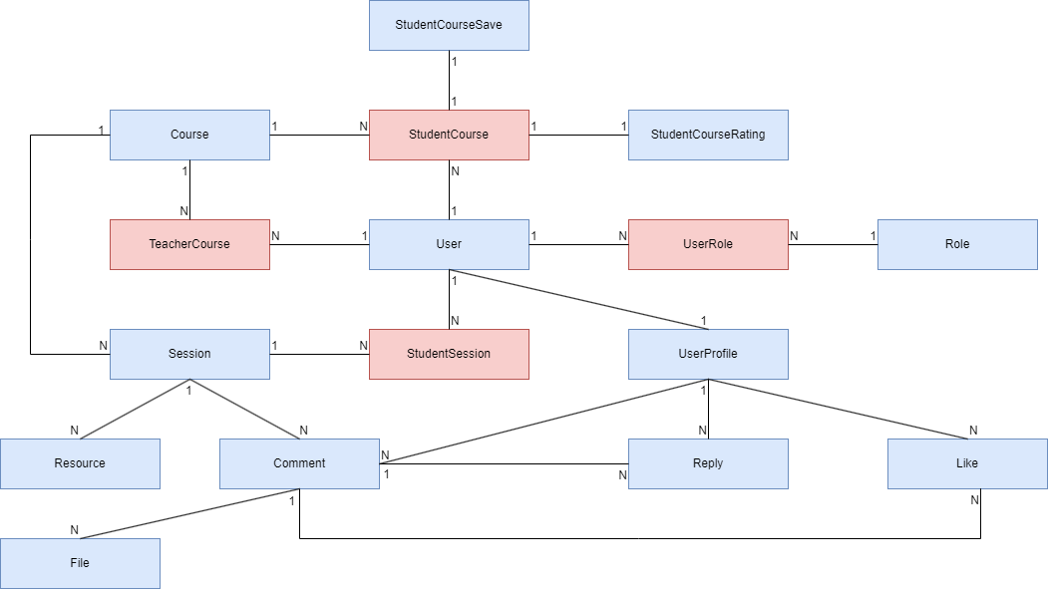

Slide 14
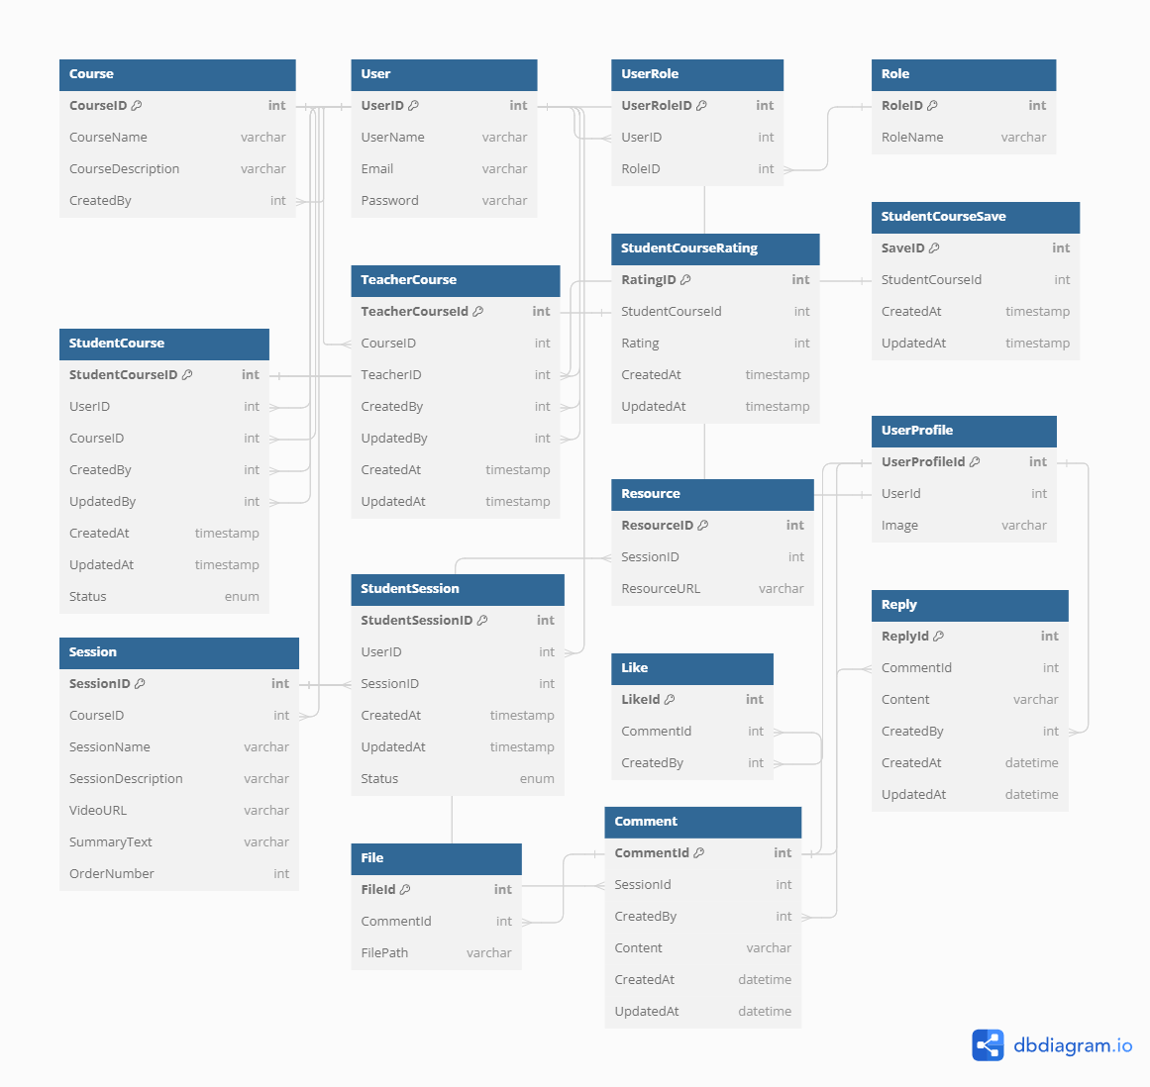

Slide 15


Thank you
I really appreciate your time.

